Slide 1
Graph
Il-Chul Moon Dept. of Industrial and Systems Engineering KAIST
icmoon@kaist.ac.kr

Slide 2
Weekly Objectives
This week, we study graphs.
Objectives are
Understanding the data structure of graphs
Able to implement the data structure for dense graphs
Able to implement the data structure for sparse graphs
Understanding the operations of graphs
BFS and DFS traverse
Understanding the algorithms on graphs
Dijkstra’s shortest path algorithm
Minimum Spanning Tree

Slide 3
Graphs
Examples of ordered collections, where each item may have successors and predecessors :
List : one predecessor, one successor at most
Tree : one predecessor (parent), several successors (children)
Graph : several predecessors and successors
Graph G = (V, E)
V = { v_{i} } : a finite non-empty set of vertices (or nodes)
E = { e_{i} } : a finite (possibly empty) set of edges (or arcs)
e_{i} connects two vertices in V
4
4
2
9
3
9
7
7
3
3
1
1
2
Unlabeld vertices
5
Labeled vertices
5
Labeled vertices
And Weighted edges

Slide 4
Graph terminology
adjacent, neighbor, incident
path between A and B : a sequence of edges connecting A and B
connected graph : path from each to every other vertex
connected component : graph subset containing the set of vertices reachable from a vertex and their edges
complete graph : edge for every pair of vertices
dense graph : close to complete graph |E| = O(|V|²)
sparse graph : far from complete graph |E| = O(|V|)
Adjacent vertex or Neighbor
Adjacent vertex or Neighbor
4
4
4
4
9
9
9
9
7
7
7
7
3
3
3
3
5
Disconnected
Graph
5
Connected
Graph
5
Connected
Component
5
Complete
Graph

Slide 5
Graph terminology
Cycle : a path starting from a node and ending the node itself
Directed edge : an edge with direction (source and destination)
Digraph : Directed graph.
Graph with directed edges
DAG : Directed Acyclic Graph
Directed graph without cycle
Destination
Source
4
4
4
4
9
9
9
9
7
7
7
7
3
3
3
3
5
Cycle
5
Directed Graph
Or Digraph
5
Cyclic
Digraph
5
Directed Acyclic
Graph or (DAG)

Slide 6
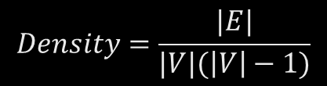
Data structure for graphs
To store a graph
Store a set of vertexes
0,1,2,3,4,5,6,7,8,9
Store a set of edges
(0,1), (1,3), (2,0), (5,3)…
How to store?
Storing vertexes
Simple.
Linked list, BST, Hash….
Store edges
Fundamentally, a pair of values
Initially, a two-dimensional matrix
Space: O(V²)
Time: O(1)
However….
Graph density becomes problem
So, adjacency list
Space: O(E)
Time: O(E)
$$Density=\frac{|E|}{|V|(\left|V\right|−1)}$$
0
2
1
Sparse graph
= Density→0
3
Dense graph
= Density→1
5
7
4
9
6
8

Slide 7
Matrix Representation for Dense Graph
Array Representation : Adjacency Matrix
Linked Representation : Adjacency List
Adjacency Matrix
A[i][j] = 1 if (v_{i}, v_{j}) ∈ E
0 otherwise
Adjacency Matrix for weighted graph
edge weight value
instead of 0/1
 |  | 0 | 1 | 2 | 3
 |  | A | B | C | D
0 | A | 0 | 0 | 0 | 0
1 | B | 1 | 0 | 1 | 1
2 | C | 0 | 0 | 0 | 0
3 | D | 0 | 0 | 1 | 0
A
D
B
C
 |  | 0 | 1 | 2 | 3
 |  | A | B | C | D
0 | A | 0 | 0 | 0 | 0
1 | B | 7 | 0 | 11 | 5
2 | C | 0 | 0 | 0 | 0
3 | D | 0 | 0 | 2 | 0
A
7
5
D
B
2
11
C

Slide 8
Adjacency List Representation for Sparse Graph
Adjacency matrix : storage waste for sparse graph
Adjacency list
For each vertex, make a linked list of edges starting from the vertex
Edge weight can be stored in ‘Edge’
Storage efficient
Vertex (name, list of edges)
A
Edge (end vertex, cost, next edge)
A
7
5
D
B
B
A
7
C
11
D
5
2
Graph
11
C
C
D
C
2

Slide 9
Operations of graph data structure
Operations on graphs
Operation of retrieving vertexes
BFS traverse
DFS traverse
Operation of finding shortest paths
The shortest path
From vertex 1
To vertex 9
Operation of finding a set of path to control whole vertexes
The minimum spanning tree
0
2
1
3
5
7
4
9
6
8

Slide 10
Detour: Tree traversing
Tree
Complicated than a list
Multiple ways to show the entire dataset
If it were a list
Just show the values from the beginning to the end
Since this is a BST
You have to choose what to show at a time
The value in LHS
The value in RHS
The value that you have
Hence there are multiple traversing approaches
Inserting 3, 2, 0, 5, 7, 4, 6, 1, 9, 8
LHS
RHS
Level 1
3
Level 2
2
5
Level 3
0
4
7
Level 4
1
6
9
Level 5
8

Slide 11
DFS vs. BFS traverse on graphs
DFS utilizes
Stacks, or recursions that imitates the stack operations
Pre-order traverse
In-order traverse
Post-order traverse
In graphs, often only pre-order traverse is used
BFS utilizes
Queues
Lever-order traverse
Having said this,
Tree is a directed acyclic graph.
Graph may not be a DAG
Then….
You have to check the repeated visits to avoid falling into a cycle
0
2
1
3
5
7
4
9
6
8

Slide 12
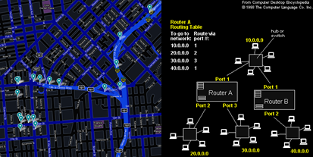
Single-Source Shortest Path Problem
One recurring problem in graph
Happens in
Path finding
Routing on comm. networks
Social networks
We know where we are
We want to know how long to travel to our destination
Terminology
Source = where we start
Destination = where we arrive
S
(0)
20
2
(8)
3
5
1
(3)
7
6
15
D (13)
3
(9)
4

Slide 13
Detour: Dynamic Programming
F(4)
Dynamic programming:
A general algorithm design technique for solving problems defined by or formulated as recurrences with overlapping sub-instances
In this context, Programming == Planning
Main storyline
Setting up a recurrence
Relating a solution of a larger instance to solutions of some smaller instances
Solve small instances once
Record solutions in a table
Extract a solution of a larger instance from the table
F(3)
F(2)
F(2)
F(1)
F(1)
F(1)
F(0)
F(0)
Memoization Table
Instance | Solution
F(0) | 0
F(1) | 1
F(2) | 1
F(3) | 2
F(4) | ?

Slide 14
Detour: Tracing Assembly Line Scheduling in DP
Assembly Line 1
station S_{1,1}
station S_{1,2}
station S_{1,3}
station S_{1,4}
station S_{1,5}
station S_{1,6}
7
9
3
4
8
4
2
1
3
4
3
2
3
Production Start
Production End
2
1
2
2
1
4
2
8
5
6
4
5
7
station S_{2,1}
station S_{2,2}
station S_{2,3}
station S_{2,4}
station S_{2,5}
station S_{2,6}
Assembly Line 2
Time | 1 | 2 | 3 | 4 | 5 | 6
L1 | 9 | 18 | 20 | 24 | 32 | 35
L2 | 12 | 16 | 22 | 25 | 30 | 37
Trace | 1 | 2 | 3 | 4 | 5 | 6
L1 |  | 1 | 2 | 1 | 1 | 2
L2 |  | 1 | 2 | 1 | 2 | 2

Slide 15
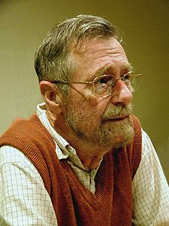
Dijkstra’s algorithm
Computer science is no more about computers than astronomy is about telescopes.
Memoization Table
V = the set of vertexes
W = the set of weights on edges
s = the source vertex
Dijkstra’s algorithm(V, W,s)
dist = {}
For itr in V
dist[v] = 99999
dist[s] = 0
While size(V) != 0
u = getVertexWithMinDistance(V, dist)
V.remove(u)
For neighbor in getNeighbors(u)
If dist[neighbor] > dist[u]+w(u,neighbor)
dist[neighbor] = dist[u]+w(u,neighbor)
Return dist
Retrieving minimum distance from a list. Does that ring a bell?
S
(0)
20
9
D (20)
3
(9)
4
Will I update the time 20 with time 9+4?
Somehow, I know it takes 9 to reach 3

Slide 16
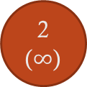
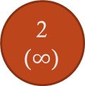
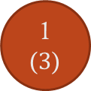
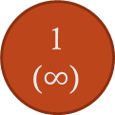
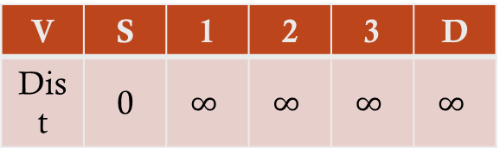
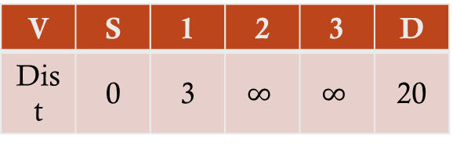
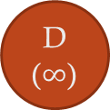
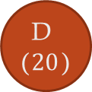
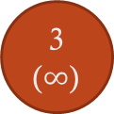
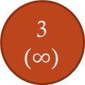
Progress of Dijkstra’s algorithm (1)
S
(0)
20
S
(0)
20
2
($∞$)
2
($∞$)
3
5
3
5
1
($∞$)
1
($3$)
7
7
6
15
15
6
D ($∞$)
D ($20$)
3
($∞$)
3
($∞$)
4
4
V | S | 1 | 2 | 3 | D
Dist | 0 | $$∞$$ | $$∞$$ | $$∞$$ | $$∞$$
V | S | 1 | 2 | 3 | D
Dist | 0 | 3 | $$∞$$ | $$∞$$ | 20

Slide 17
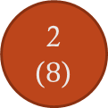
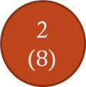
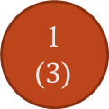
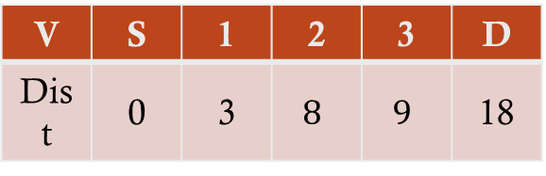
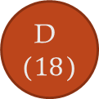
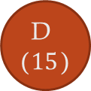
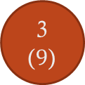
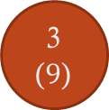
Progress of Dijkstra’s algorithm (2)
S
(0)
20
S
(0)
20
2
($8$)
2
($8$)
3
5
3
5
1
($3$)
1
($3$)
7
7
6
15
15
6
D ($18$)
D ($15$)
3
($9$)
3
($9$)
4
4
V | S | 1 | 2 | 3 | D
Dist | 0 | 3 | $$8$$ | $$9$$ | 18
V | S | 1 | 2 | 3 | D
Dist | 0 | 3 | 8 | 9 | 15

Slide 18

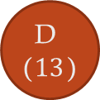
Progress of Dijkstra’s algorithm (3)
Time complexity
O( (|E|+|V|)log|V| )
We will not prove this
|E|
The number can vary
It can be close to
1 = dense graph
0 = sparse graph
If it is a dense graph,
|E| is almost equal to |V| X |V|
Then?
O( |V|²log|V| )
More than a quadratic time complexity
Pretty expensive!
S
(0)
20
2
($8$)
3
5
1
($3$)
7
6
15
D ($13$)
3
($9$)
4
V | S | 1 | 2 | 3 | D
Dist | 0 | 3 | $$8$$ | $$9$$ | 13

Slide 19
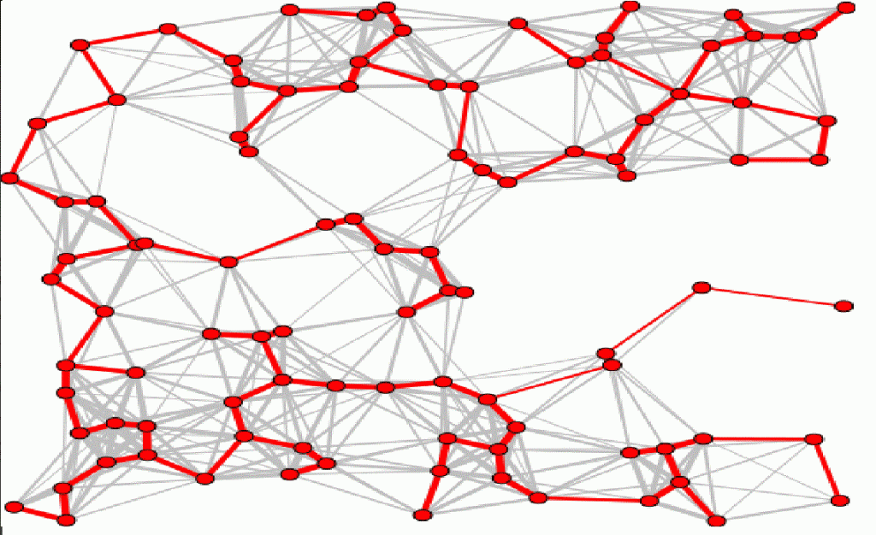
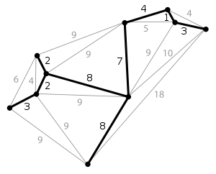
Minimum Spanning Tree Problem
Shortest-path problem
Path planning from a selected source
Many times, algorithm for planning
Minimum spanning tree
Network control problem
All vertex coverage with minimum cost
Algorithm from network design
Telephone network
Electricity grid network
TV cable network
Computer network
Road network
Evolving to the influence propagation tree
Social network influence
From one politician to all tweeter accounts

Slide 20
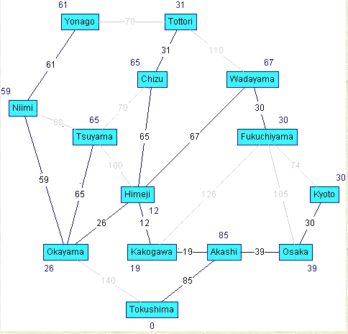
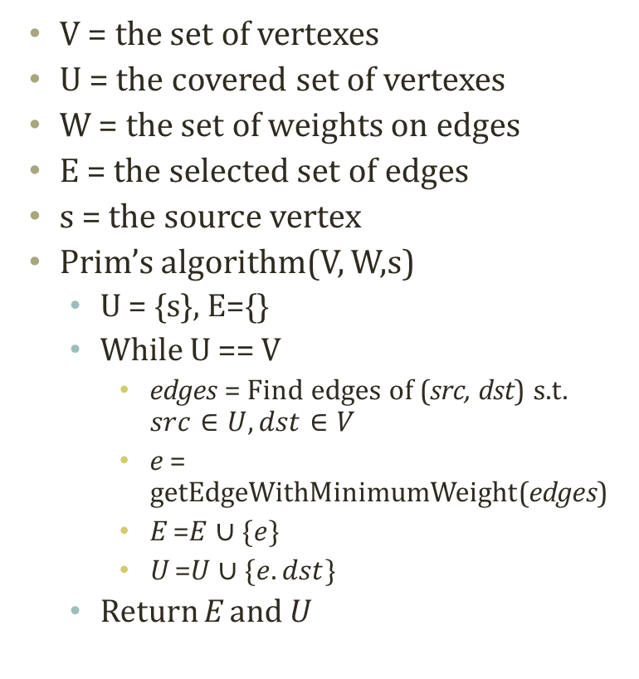
Prim’s algorithm
V = the set of vertexes
U = the covered set of vertexes
W = the set of weights on edges
E = the selected set of edges
s = the source vertex
Prim’s algorithm(V, W,s)
U = {s}, E={}
While U == V
edges = Find edges of (src, dst) s.t. $src∈U, dst∈V$
e = getEdgeWithMinimumWeight(edges)
E =$E∪\{e\}$
U =$U∪\{e.dst\}$
Return E and U
Uncovered Nodes
Covered Nodes
3
1
3
Edges of don’t care
15
9
4
5
Edges of don’t care
13
Edges of don’t care
2
2
20
5
Edges to consider

Slide 21
Progress of Prim’s Algorithm (1)
1
20
1
20
4
4
3
5
3
5
2
2
7
7
6
15
6
15
5
5
3
3
4
4
V={1,2,3,4,5}
U={1}
E={}
V={1,2,3,4,5}
U={1,2}
E={(1,2)}

Slide 22
Progress of Prim’s Algorithm (2)
1
20
1
20
4
4
3
5
3
5
2
2
7
7
6
15
6
15
5
5
3
3
4
4
V={1,2,3,4,5}
U={1,2,4}
E={(1,2),(2,4)}
V={1,2,3,4,5}
U={1,2,3,4}
E={(1,2),(2,4),(2,3)}

Slide 23
Progress of Prim’s Algorithm (3)
Time complexity
O( (|E|+|V|)log|V| )
We will not prove this
Same time complexity to the Dijkstra’s algorithm
1
20
4
3
5
2
7
6
15
5
3
4
V={1,2,3,4,5}
U={1,2,3,4,5}
E={(1,2),(2,4),(2,3),(3,5)}

Slide 24
Further Reading
Introductions to Algorithms by Cormen et al.
pp. 527-619

